Slide 1
Chapter 10
Servlets and Java Server Pages
Programming the World Wide Web
Fourth edition
By Robert W. Sebesta

Slide 2
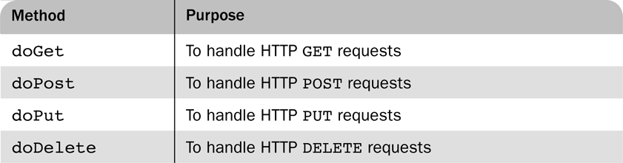
Table 10.1 Commonly used methods of
HttpServlet

Slide 3
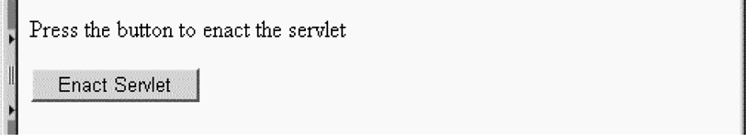
Figure 10.1 Display of tstGreet.html

Slide 4
Figure 10.2 The response from the Greeting servlet

Slide 5
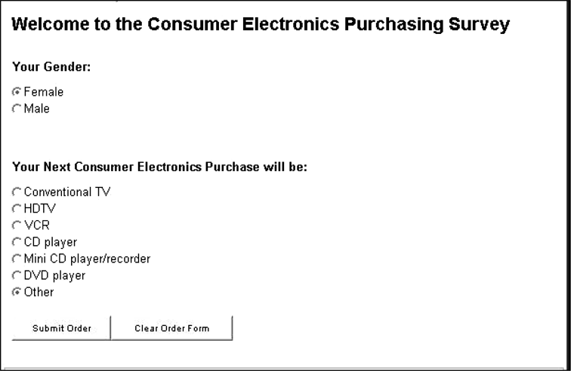
Figure 10.3 Display of conelec2.html

Slide 6
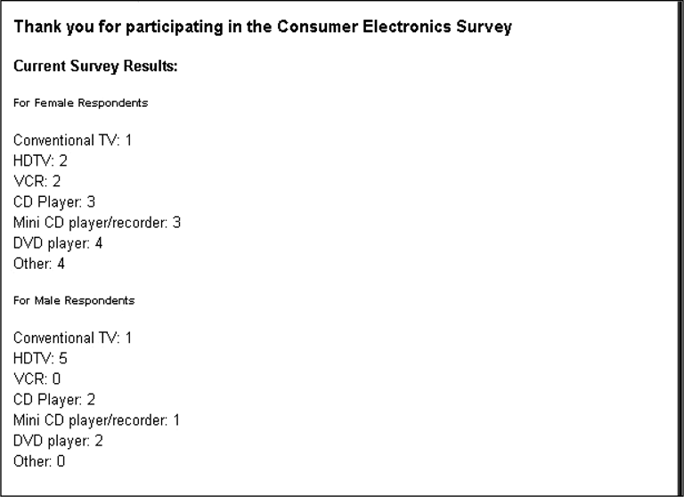
Figure 10.4 Results of the Survey servlet

Slide 7
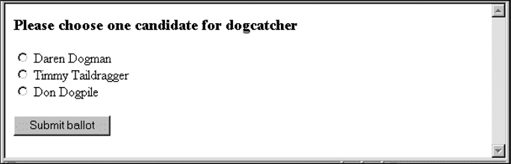
Figure 10.5 Display of ballot.html

Slide 8
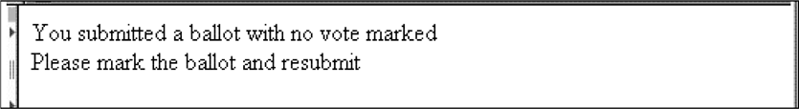
Figure 10.6 The output of the VoteCounter servlet for a form with no vote

Slide 9
Figure 10.7 The output of VoteCounter for a form with a second vote from the same client

Slide 10
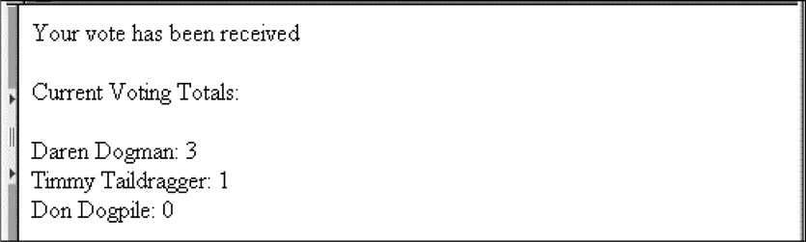
Figure 10.8 The output of VoteCounter for a form with a legitimate vote

Slide 11
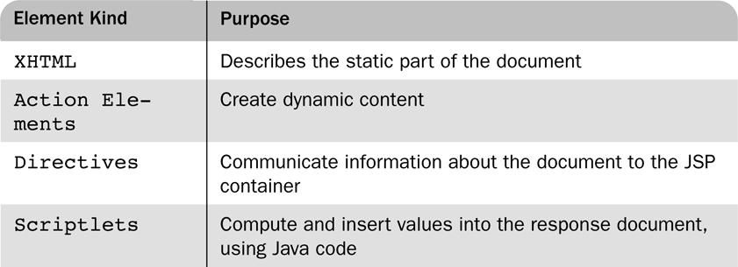
Table 10.2 JSP document elements

Slide 12
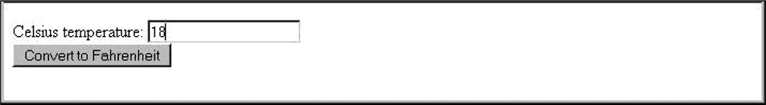
Figure 10.9 A listing of the initial version of tempconvert3.jsp

Slide 13
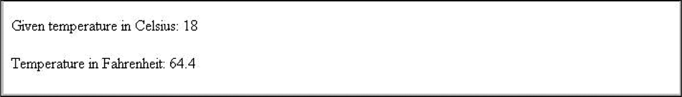
Figure 10.10 The listing of tempconvert3.jsp after submitting the original

